Slide 1

Transfer Learning for Prediction
Hua Zuo
Centre for Artificial Intelligence (CAI)
Faculty of Engineering and Information Technology
University of Technology Sydney (UTS)

Slide 2
Content
1. Introduction
2. Motivation of Transfer Learning
3. Transfer Learning Methods
4. Application of Transfer Learning
5. Further Study

Slide 3

What is Transfer Learning?
Transfer learning is a method to use the previously acquired knowledge to improve the efficiency and accuracy of a different but related problem.
Notes:
First, what is TL?
Transfer learning is….
Next, we will give two examples to illustrate the transfer learning method and the motivation behind this.

Slide 4
Motivation 1: Data changes rapidly
The usage behavior of mobile phone is changing rapidly
Mobile phone (2000-2013): Call, Message
Mobile phone (2014-2018): Games, Videos, Twitter, Tax return, Boarding pass
Notes:
The first example.
1.About ten years ago, the main functions of mobile phone are … make a call, and send messages
But nowadays, what we use the mobile phone for? We use it to …play games, watch vides, and surf the internet
2.If we built a model five years ago to predict the mobile phone’s market penetration, can we use the model for the phone today?
Of course not, because the distribution of data is different.
3.But it is wasteful to discard all the historical data, because they have the similar even same feature space with current data, although the distributions are different.
TL method try to learn and exploit….

Slide 5
Motivation 2: Data Shortage
To predict the status of banking system B, limited labeled data are available.
We have sufficient data for banking system A. Since A has different features with B, its data cannot be directly used for B’s prediction.
Data sufficient (banking System A)
(No. of banks: 3103 (2000); 3046 (1999))
Data shortage (Banking System B)
No. of banks: 15 (2000, 1999)
f1 | Capital ratio
f2 | Loan loss allowance
f3 | Past due loan measure
f4 | Provision rate
f5 | Non-interest profit
f6 | Net interest margin
f7 | Return on equity
f8 | Liquidity measure
f9 | Loan growth
g1 | Liquid assets | g10 | Capital ratio
g2 | Uninsured deposits | g11 | Return on assets
g3 | Loan Exposure | g12 | Return on equity
g4 | Loan funding | g13 | Dividend rate
g5 | Nonaccrual rate | g14 | Net interest margin
g6 | Past due loan rate | g15 | Net operating margin
g7 | Loan loss allowance | g16 | Tax exposure
g8 | Provision rate | g17 | Capital growth
g9 | Loss rate | g18 | Loan growth
Notes:
1. The second example is that

Slide 6
Transfer Learning for Prediction
In classical Machine Learning methods, there is an assumption that the training data and the testing data must be in the same feature space and have the same distributions.
Transfer Learning can be used to handle the situations:
Same feature space but different distributions (data distribution changes rapidly)
Different feature spaces (labeled data shortage)
Two types of prediction problems: Classification and Regression
Human-beings can utilize the knowledge, which learned previously, to solve upcoming similar but not identical problems, much faster and even better.
Transfer Learning (learning to learn, life-long learning, meta learning, multi-task learning) was emerged in 1995, aims to exploit the knowledge accumulated from data in some auxiliary domains to facilitate predictive modeling in the current domain.
Notes:
Transfer learning can handle the above two mentioned issues in machine learning.
Because in classical machine learning…… But if the distributions or feature space have changed, the traditional ML methods can’t be used. Transfer learning could handle these two issues…
The aim of TL is to exploit …

Slide 7
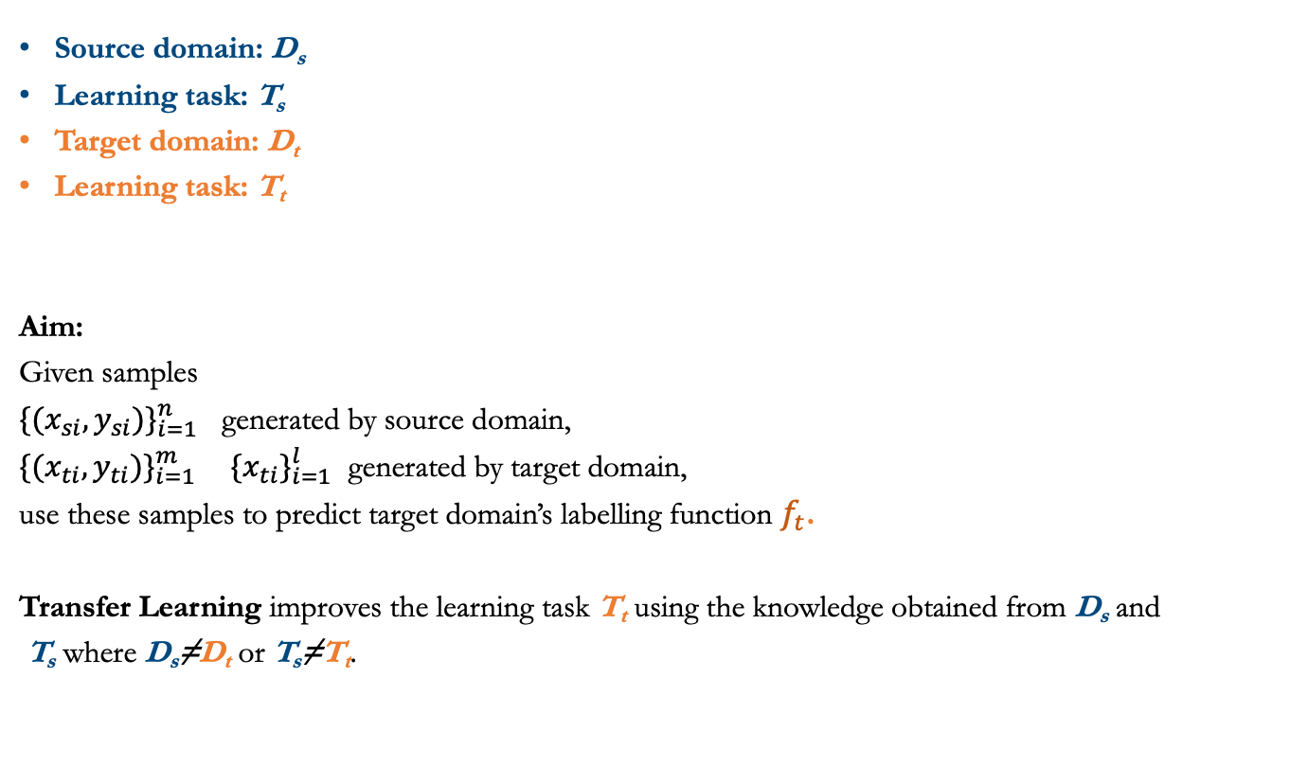
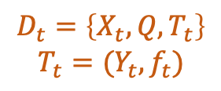
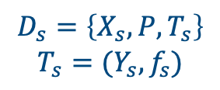
Transfer Learning Concept
Source domain: D_{s}
Learning task: T_{s}
Target domain: D_{t}
Learning task: T_{t}
Aim:
Given samples
${\{(x_{si}, y_{si})\}}_{i=1}^{n}$ generated by source domain,
${\{(x_{ti}, y_{ti})\}}_{i=1}^{m} {\{x_{ti}\}}_{i=1}^{l}$ generated by target domain,
use these samples to predict target domain’s labelling function $f_{t}$.
Transfer Learning improves the learning task T_{t} using the knowledge obtained from D_{s} and
T_{s} where D_{s}≠D_{t} or T_{s}≠T_{t}.
Source domain
Target domain
$$D_{s}=\left\{X_{s}, P, T_{s}\right\}$$
$$T_{s}=(Y_{s}, f_{s})$$
$$D_{t}=\left\{X_{t}, Q, T_{t}\right\}$$
$$T_{t}=(Y_{t}, f_{t})$$
Notes:
1. Now let’s look at the concept of TL.
There is a source domain and a target domain. In the source domain,…. In the target domain,…
TL improves…
2. Generally, there are two categories of transfer learning methods….
Also there are other ways of dividing TL methods. For examples, depending on the amount of labeled data in the target domain, there are semi-supervised and unsupervised.
3.Most of the TL methods are based on the data transfer, and lack the ability of extracting a higher level of knowledge.
And they ignore the phenomenon of information granularity. So fuzzy system is introduce to TL to deal with this issue.

Slide 8
Transfer Learning Categorization
Supervised transfer learning
Most of samples in target domain are labeled;
Semi-supervised transfer learning
Small part of the samples in target domain are labeled;
Unsupervised transfer learning
No part of the samples in target domain are labeled

Slide 9
Transfer Learning Categorization
When D_{s}≠D_{t} (D={F, P(X)}) we have
1) F_{t}=F_{s} but P_{t}(X)≠P_{s}(X)—different distributions
-----Domain Adaptation Method (Homogeneous Transfer Leaning Method)
Labelled source domains
target domains
f1 | f2 | f3 | f4 | f5
f1 | f2 | f3 | f4 | f5
2) F_{t}≠F_{s} and P_{t}(X)≠P_{s}(X)—different feature spaces
-----Cross-Domain Adaptation Method (Heterogeneous Transfer Learning Method)
Labelled source domains
target domains
f1 | f2 | f3 | f4 | f5
f1 | f2 | g1 | g2 | g3 | g4
g1 | g2 | g3 | g4 | g5 | g6
9

Slide 10

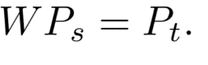

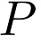

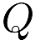
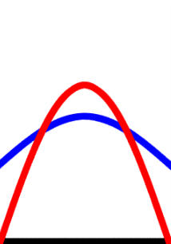


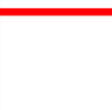

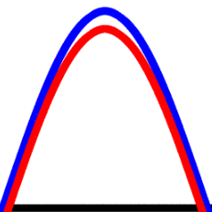
Basic methods
Instance Reweighting
Reweight source domain’s distribution so that reweighted source distribution target distribution are similar:

Slide 11
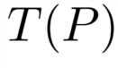
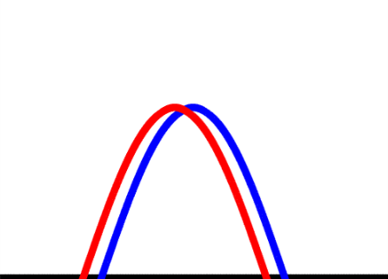

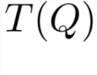
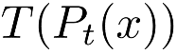
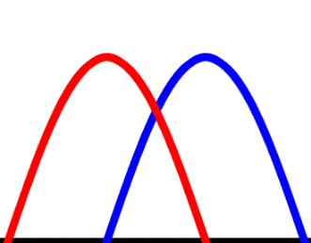

Basic methods
Feature matching
Try to find transformation T to map feature space into a latent space, where the new distributions are similar:

Slide 12
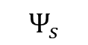
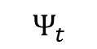
Convert Cross-Domain Adaptation to Domain Adaptation by Mappings
Source domain
feature space
Target domain
feature space
Cross-Domain Adaptation Problem
f1 | f2 | f3 | f4 | f5
g1 | g2 | g3 | g4 | g5 | g6
Unsupervised learning
h1 | h2 | h3 | h4
Latent feature space
Source and target data are represented by more abstract features
Source domain
feature space
Target domain
feature space
Domain Adaptation Problem
h1 | h2 | h3 | h4
Same features
h1 | h2 | h3 | h4
Notes:
The core part of the cross-domain adaptation method is to extract a latent feature space, that can be shared between the source and target domains.
Two mappings are learned in an unsupervised way to map the source and target data into the latent feature space.
The features in the latent feature space have more abstract meanings, or even don’t have explicit meanings.
After transforming the data to the latent feature space, the data in two domains have the same representations, the same feature space with different distributions, so the cross-domain problem is converted to domain adaptation problem.

Slide 13
Basic methods
Granular transfer learning
To employ transfer learning to predict accurately, precise values of features need to be replaced by granular values to capture the resemblance between two domains.
Mobile storage capacity of 256 GB is “large memory” today, while 1 GB was recognised as “large memory” for a similar device 10 year ago.
The precise values (“256 GB” and “1 GB”) need to be expressed as granular value (“large memory”) to facilitate transfer learning.
2010
2019
1 GB
large memory
256 GB
large memory

Slide 14
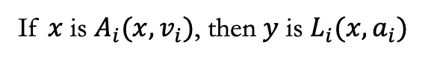
Basic methods
Fuzzy rule-based transfer learning
Source domain
Target domain
Rule s2
Rule t1
Rule s1
If $x$ is $A_{i}(x, v_{i})$, then $y$ is $L_{i}(x, a_{i})$
Rule s3
Rule t2
Rule
t3
IF temperature is not high
THEN fan speed is slow
Notes:
1. Now let me explain the advantage of using fuzzy systems in knowledge transfer.
2. In the source domain, we have the text data. In the target domain, we have the numerical data.
For the source domain, a set of rules can be learned, which represent a higher level of knowledge. But the in the target domain we can’t get these rules.
3. The rules are described by abstract terms other than specific numbers or data, like the linguistic rules, for example….
And there is a cluster-based rule model, where the rules are represented by the clusters an the actions defined in the clusters.
These model could extract the abstract knowledge and facilitate the knowledge transfer
4. In our method, we will use the cluster-based fuzzy rules model.

Slide 15
TL in Deep Learning
Commonly used deep NN for feature extraction:
VGG16
ResNet50
ImageNet
AlexNet

Slide 16
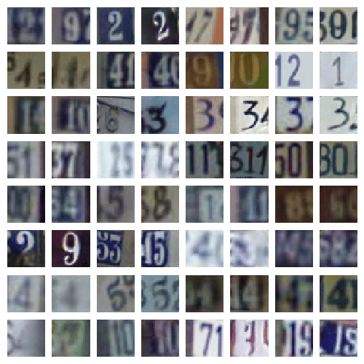
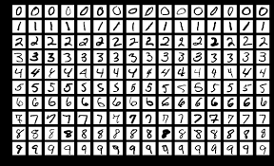
Application 1: handwritten digit recognition
A model trained using the “MNIST handwritten digit” to facilitate the recognition of digital images from other sources.
MNIST handwritten digit datasets
Pictures download from the internet
Notes:
We can use the data from the “MNIST handwritten digit” to train a well-performed model for classifying the handwritten digits.
TL method can transfer the knowledge of the “MNIST handwritten digit” to recognize the digital images download from internet.

Slide 17
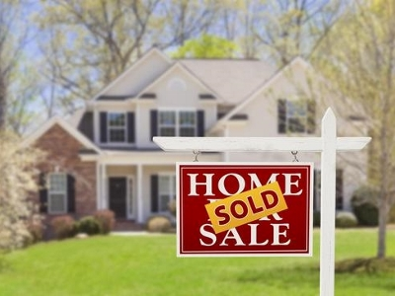


Application 2: housing forecast
We want to predict the transaction price or the number of viewings in Australia real estate market. Data is insufficient.
In US real estate market, massive amount of data are available.
Notes:
Last two examples are classification tasks. Let’s look at a regression task.
Predict the “real estate price” .
A lot of data available in the US real estate market, help to build a model to predict the transaction prices of real estate in Australia.

Slide 18

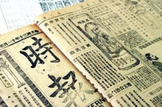
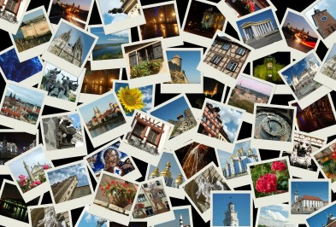

Application 3: document classification
Use the prediction model that classifies English newspapers to support Chinese newspapers’ classification.
English
Chinese
Use the image recognition model to facilitate the classification of documents.
Image
Documents
Notes:
We have built a classifier to predict the topics of the English newspapers, such as sports, entertainment, political, education, and so on. But for the Chinese newspapers, which have the same topic categories with the English newspaper, don’t have sufficient labeled data, and label them need more money and labor. We could use the existing model for English newspapers to support the classification of Chinese newspapers.
Let’s consider a more challenging problem:
For millions of images, we can classify them into different groups, such people, building, views, and so on. For the documents, similar but different categories, biography, travelogue, architectural design. So the two domains have different feature space, also different label space. TL method can use the knowledge of images to support the documents’ classification task.

Slide 19
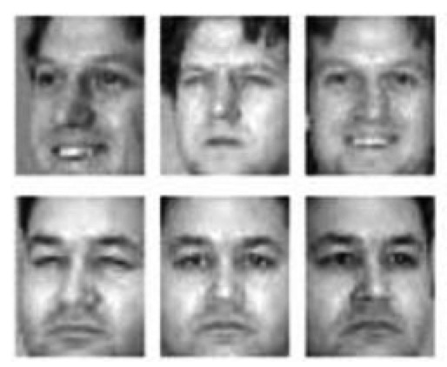
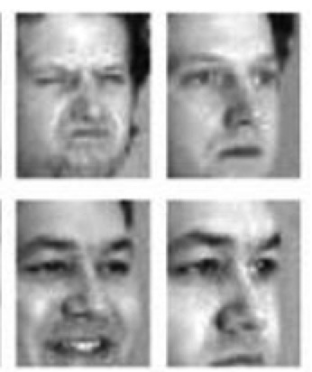
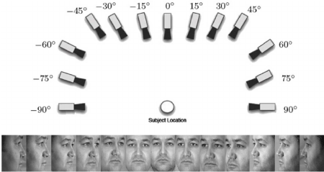
Application 4: face recognition
Use the images shot from left or front to recognize the image shot from other angles (right).
Use the images shot from certain light angle and strength to recognize the images got in different angles and light strength.

Slide 20



Application 5: recommender system
A recommender system is built for the movies, and rating matrix is well filled.
Now, we hope to recommend the books to the customers.
4 | 4 | 2 | 1
4 | 3 | 5 | 2
5 | 3 | 2 | 2
2 | 3 | 4 | 1
 | 5 | 2
4 | 1
 | ? |  | 2
 | 3 |  | 1
Notes:
The categories of movies include action, adventure, historical, crime, drama, and so on.
Also, the books have the similar categories.
We can build the relation between the two domains, and use the recommender system for movies to build a recommender system for books.
Matrix decomposition

Slide 21
Multiple-source transfer learning
Cross-Domain knowledge transfer between more heterogeneous source domains and a target domain (classification)
f1 | f2 | f3 | f4 | f5
Multiple Heterogeneous
Source Domains
f2
f3
f4
f2
f4
g1
Target Domain
f3
f4
f5
Heterogeneous feature space
Cross-Domain knowledge transfer with multiple continuous outputs y1, y2 (regression)
f1
f2
y1
y2
f2
f4
g1
y1 y2
Target Domain
f3
f4
y1
y2
feature space
multiple continuous outputs

Slide 22

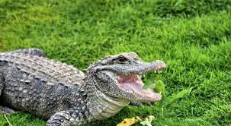
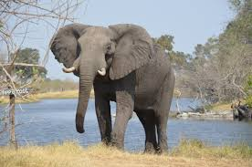
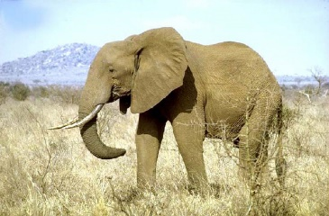
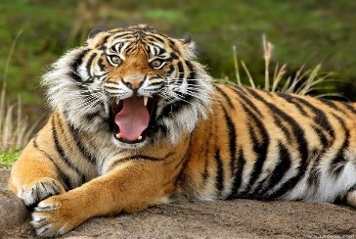
Open Set Domain Adaptation
Source domain
Target domain
African crocodile
Chinese alligator
Shared classes
African elephant
Asian elephant
South Chinese tiger
Open set domain adaptation is a new problem. Until now, Just few papers have been published.
Unknown class
22

Slide 23


